Slide 1
Registration and Submission Guide
Iranian Conference on Biomedical Engineering
http://icbme.ir/

Slide 2
Please first observe the Paper Submission Guidelines and registration sections under For Authors menu button in the website
Contact us if you have any question:
icbme2023@icbme.ir

Slide 3
General process of submitting papers in ICBME
First phase from
June 22, 2023 :
Creating an account in EDAS website
Primary submission of the paper
paying the registration fee
uploading the manuscript for review
due date
July 22, 2023
second phase from September 22, 2023 :
initial decision of peer-reviewing process
paying the final fee
final version of paper with PowerPoint/Poster
submission
Due Date October 22, 2023

Slide 4
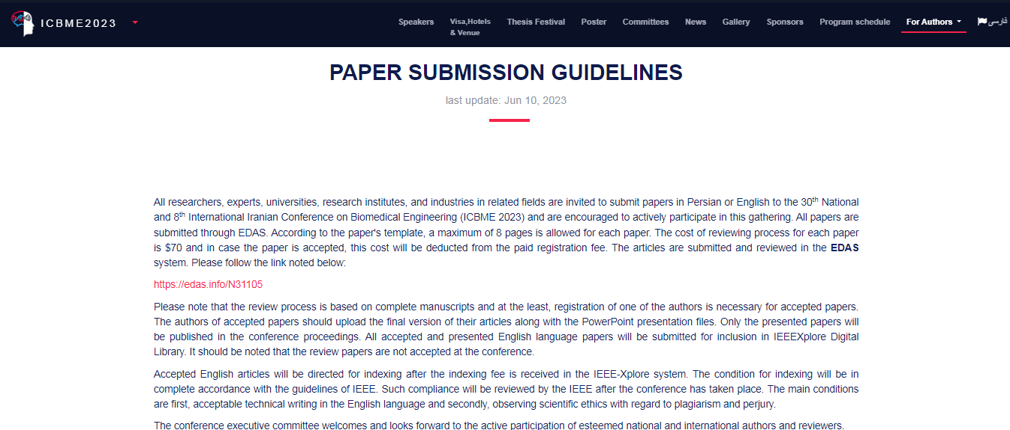
EDAS website link :
https://edas.Info/N31105

Slide 5
Creating an account in EDAS website : part 1
Resetting the password if it is forgotten : part 2
2
1

Slide 6
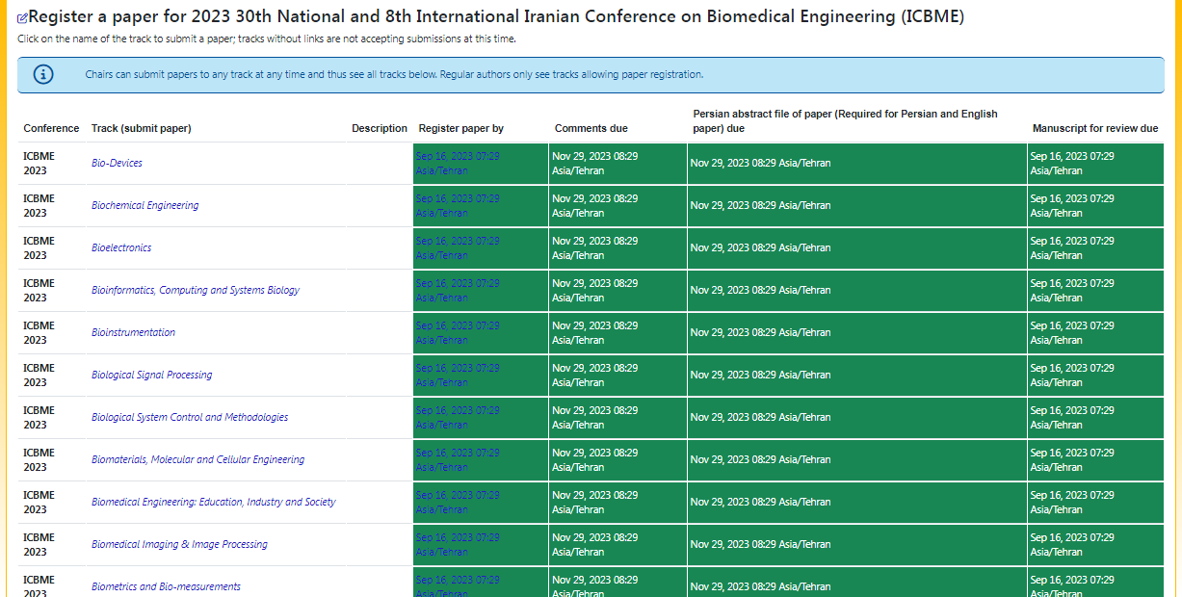
Please choose the track that is the nearest to your paper category. (Note that all the mentioned date and time are in EDT time zone.)

Slide 7
In the next page enter the primary information of your paper.

Slide 8
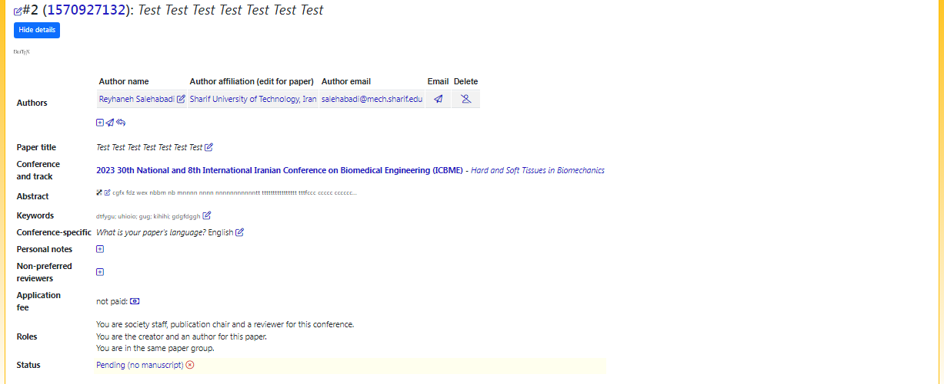
Please add all authors’ names as shown in the picture below. Every mistake at this level will affect the review process of your paper.

Slide 9
Your paper is submitted. The initial status is “pending”. After paying the application fee (which is $70), please send an email to the conference (icbme2023@icbme.ir) containing the payment information, and wait until your paper status changes to “active”. At this stage you will be able to upload your manuscript.

Slide 10
Please use the specified box for uploading your paper’s manuscript.

Slide 11
Here the system asks you to upload your paper’s Persian abstract that will be used in the conference bilingual booklet. Please upload your English abstract; the conference will translate the abstract.

Slide 12
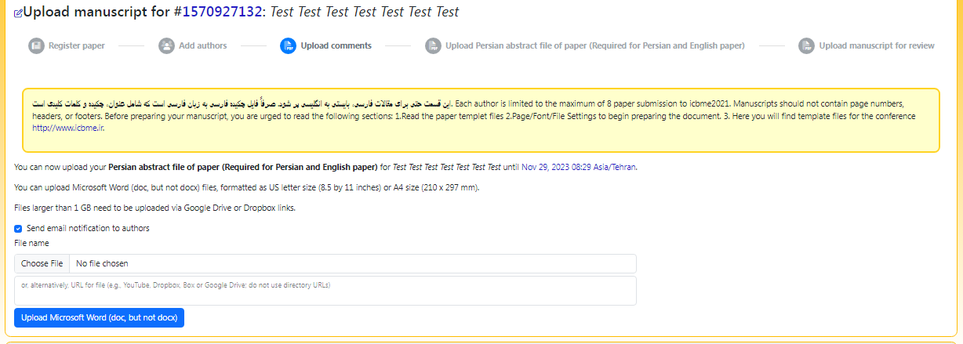
The abstract should be in “.doc” format (Microsoft word).

Slide 13
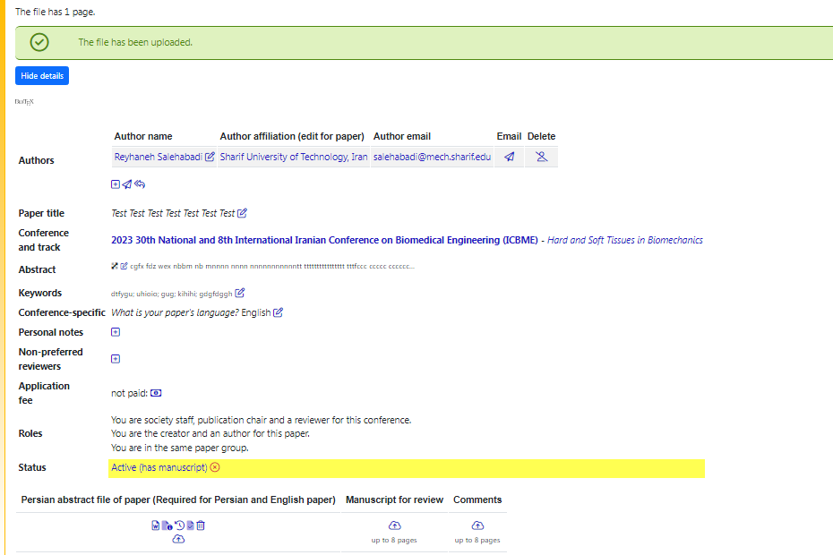
You should now see a massage saying the file has been uploaded. In the next step, the manuscript should be uploaded using the upload link.

Slide 14
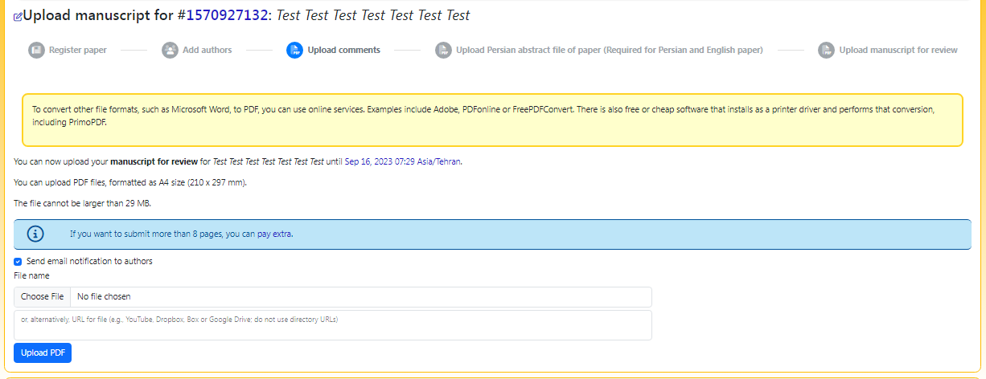
Here you can choose manuscript file and upload it. It should be a pdf file.

Slide 15
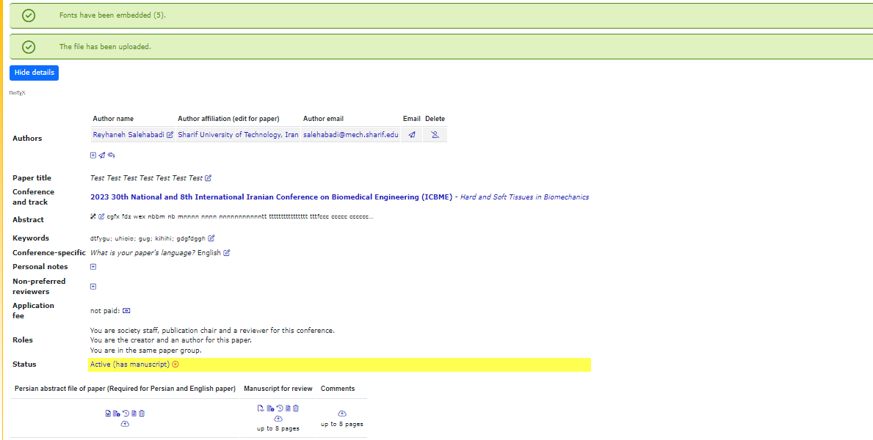
If there are any problems, you will see the errors. Please try to fix them and if you have a question contact us.

Slide 16
Iranian Conference on Biomedical Engineering
http://ww.icbme.ir/
Contact us:
icbme2023@icbme.ir

